Slide 1
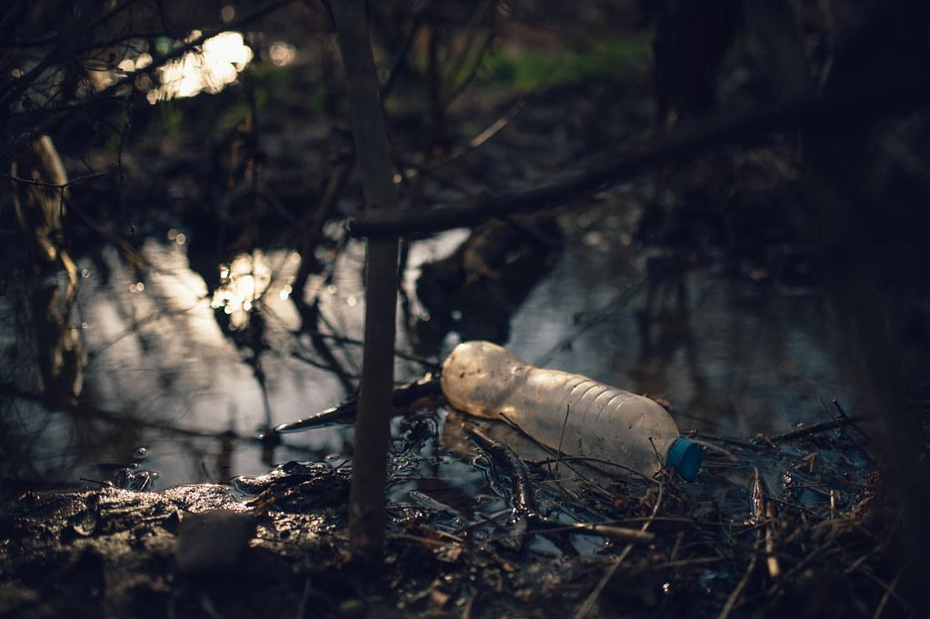

Global Plastic Pollution
Interactive Visualisation CIS4041

Slide 2
Introduction
The plastic waste crisis is a significant environmental challenge facing the world today. With the rapid growth of plastic production over the past few decades, the issue of plastic waste management has become increasingly critical.
Plastics, while versatile and useful in various industries, pose severe environmental risks when not properly managed.
Mismanaged plastic waste, particularly in developing countries, often ends up in oceans, causing widespread harm to marine life and ecosystems.

Slide 3
Objectives
This project aims to explore the scale of global plastic production, the management of plastic waste, and its impact on the environment. By analyzing data from various sources, we seek to uncover patterns, trends, and disparities in plastic waste generation and management across different regions.

Slide 4
Description of Datasets
1.Global Plastics Production Dataset
This dataset provides information on the annual production of plastics globally over a specific period.
Annual production of plastics has increased nearly 230-fold to 460 million tonnes in 2019.
The below chart shows the plastic pollution from 1950 to 2019, measured in millions tons.
A significant decrease is marked around the year 2008, indicating a temporary dip in pollution levels.

Slide 5
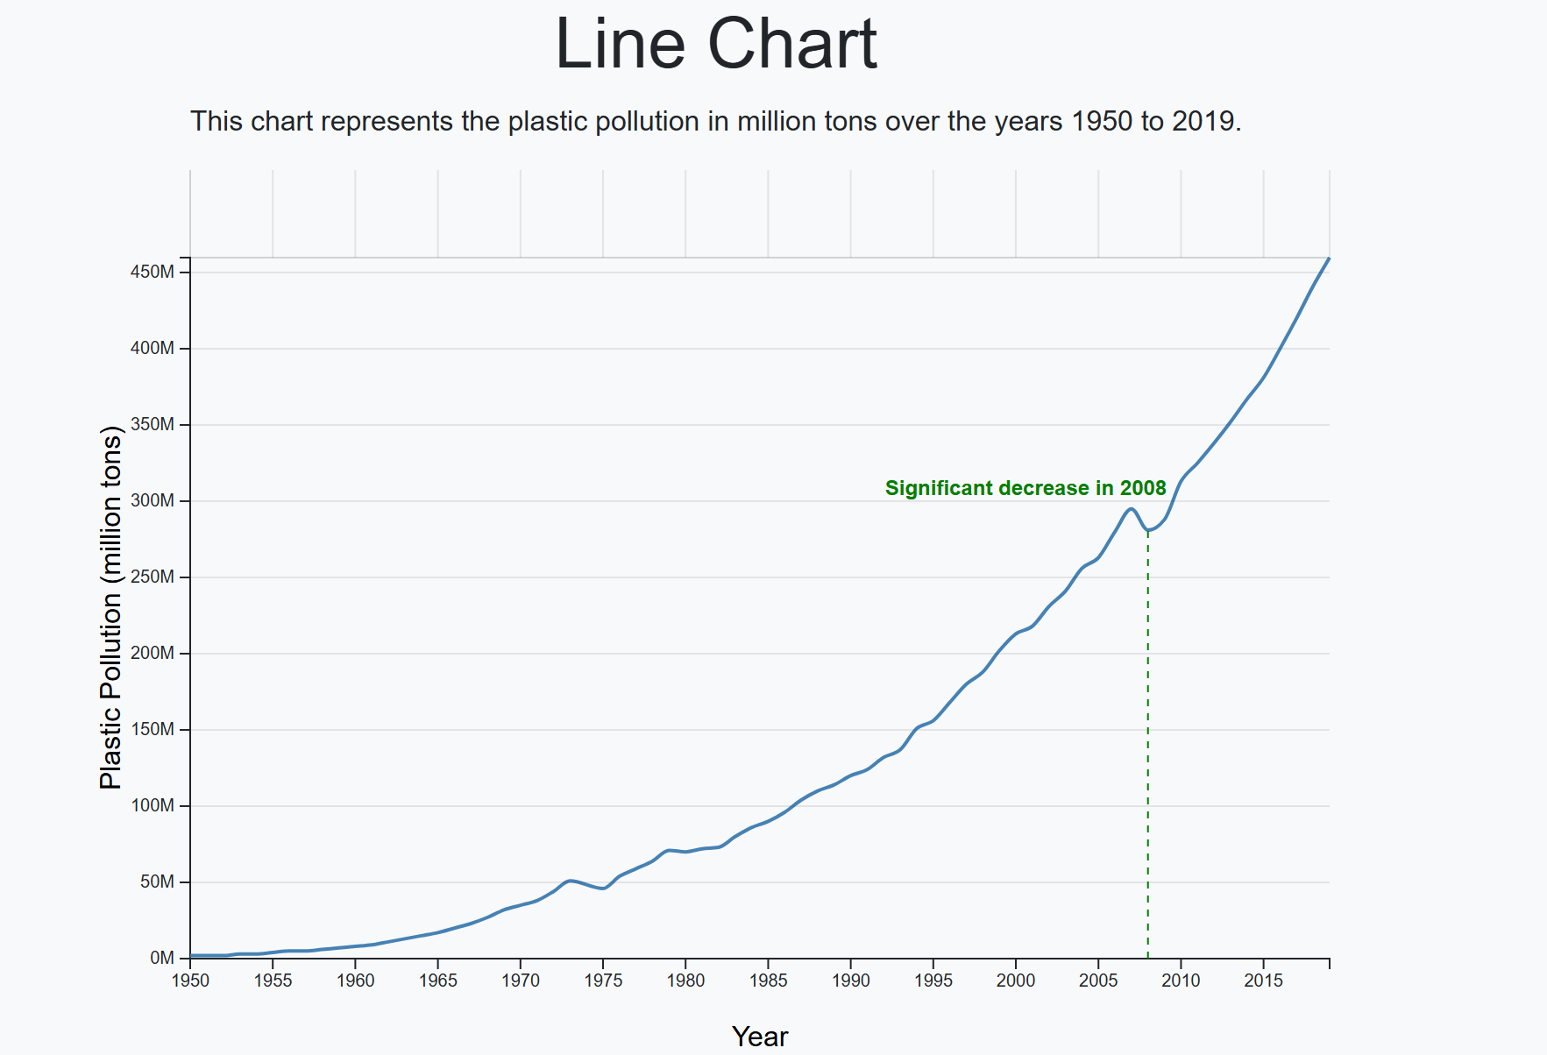

Slide 6
2.Share of Global plastic waste emitted to Ocean
The choropleth map displays the share of global plastic emitted to ocean per capita for the year 2019.
Darker shades indicate countries with higher contributions to ocean plastic waste, while lighter shades shows lower contributions.
Particularly china having the darkest shade, indicating a higher level of plastic waste emission.

Slide 7
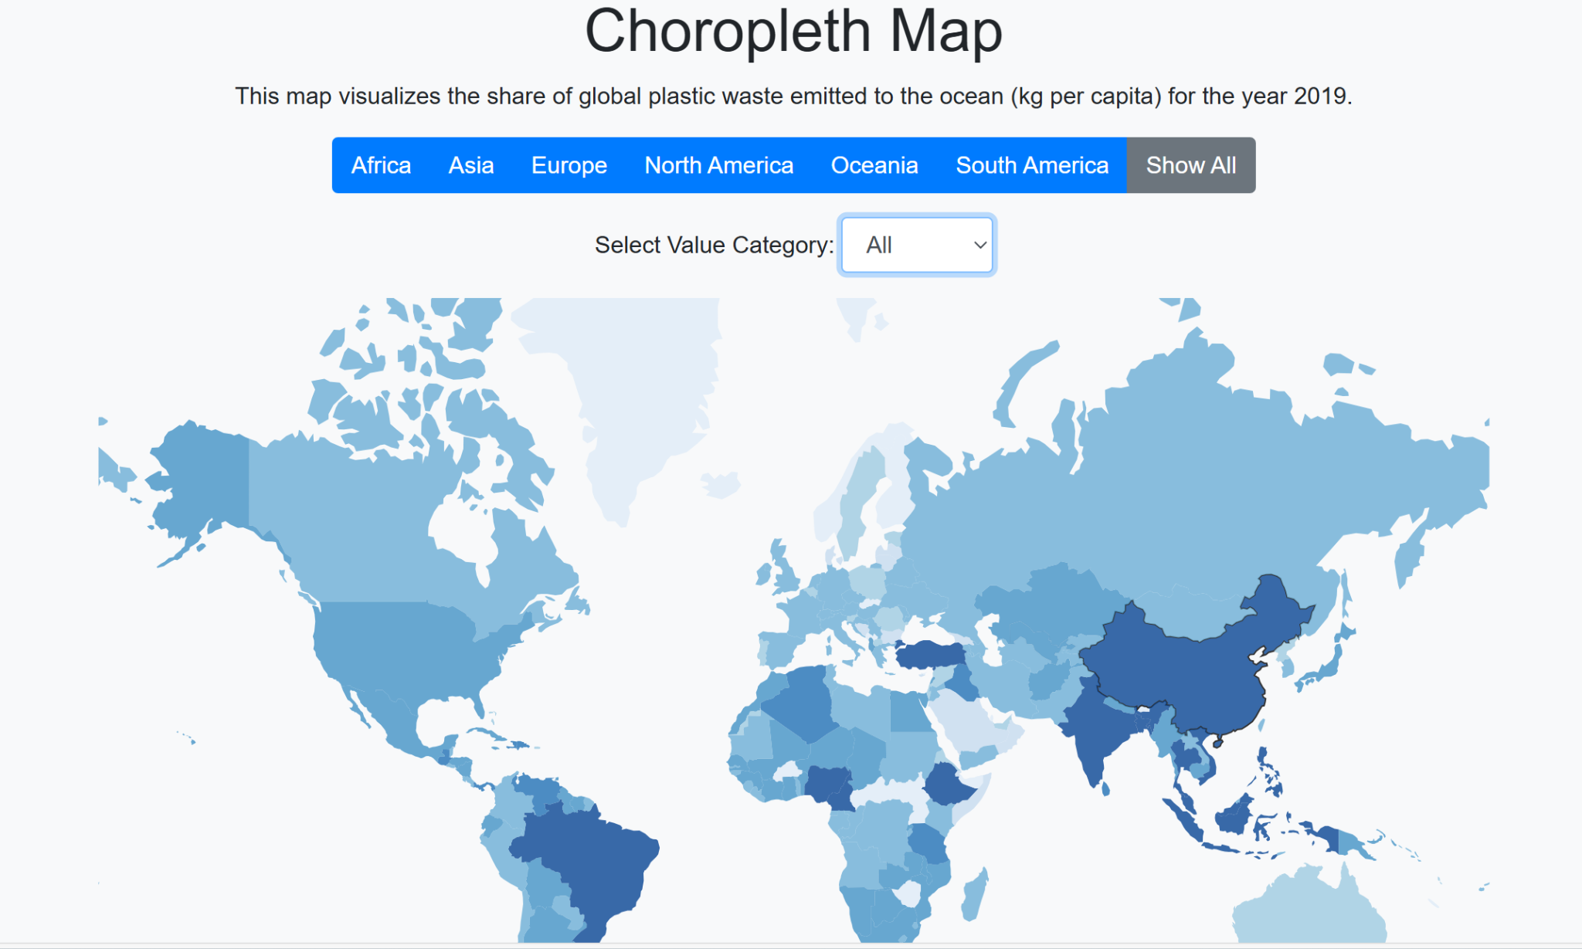

Slide 8
3. Share of plastic fate
The world’s plastic waste is recycled, only 9%.
Half of the world’s plastic still goes straight to landfill and another half is mismanaged.
When plastic enters a waste stream, it can be disposed of by landfills, incineration, or recycling.

Slide 9
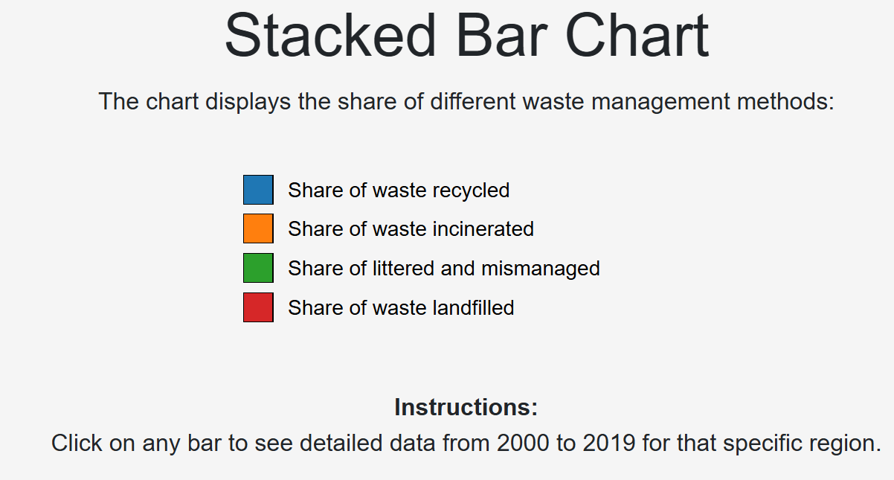
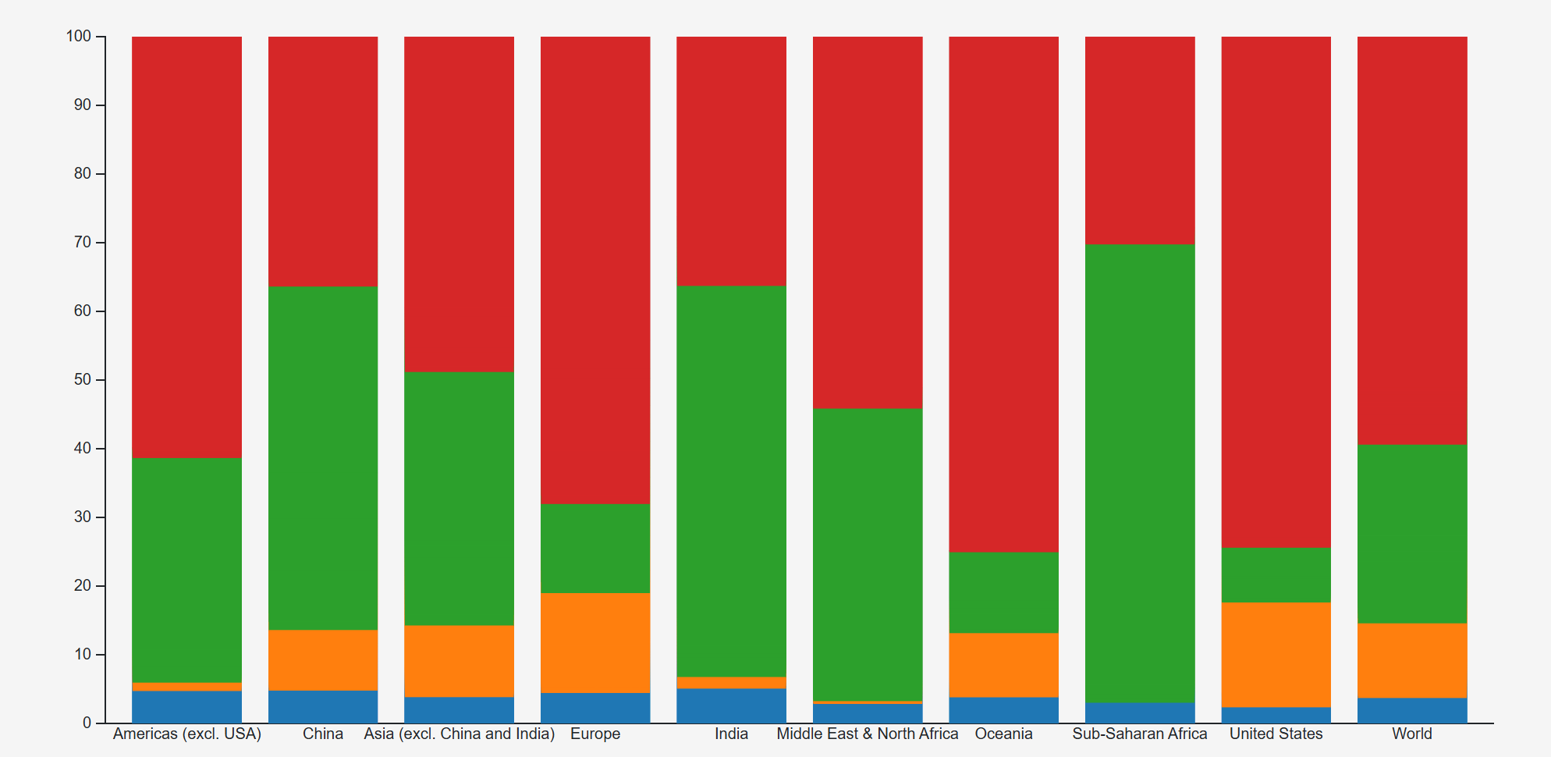

Slide 10
4.Mismanaged plastic waste per capita
Improving waste management strategies is crucial to ending plastic pollution.
It is a solvable problem, and making a difference here would do much more to reduce plastic pollution than even considerably reducing plastic pollution.
Nearly one - quarter of the world’s plastic waste is mismanaged or littered.Around 82 million tonnes.

Slide 11
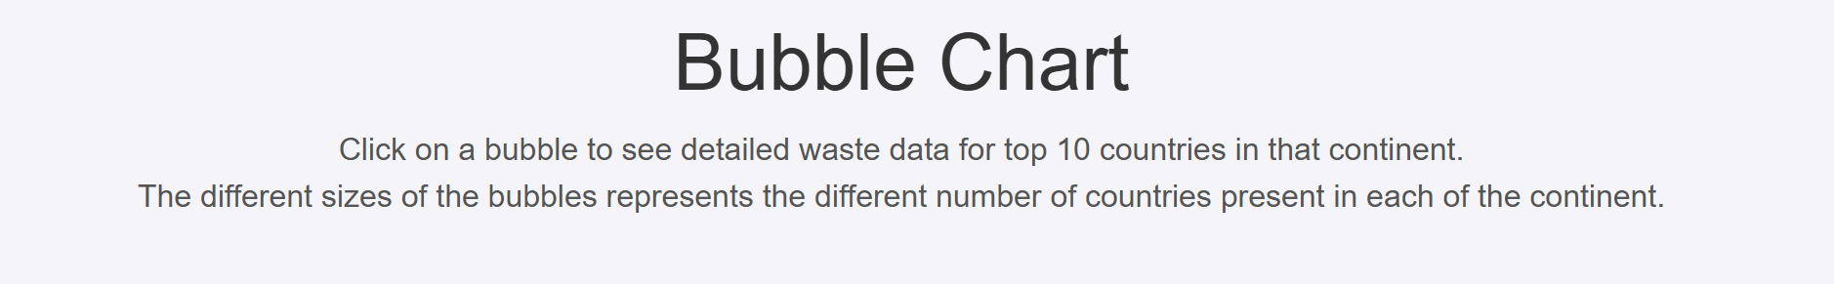
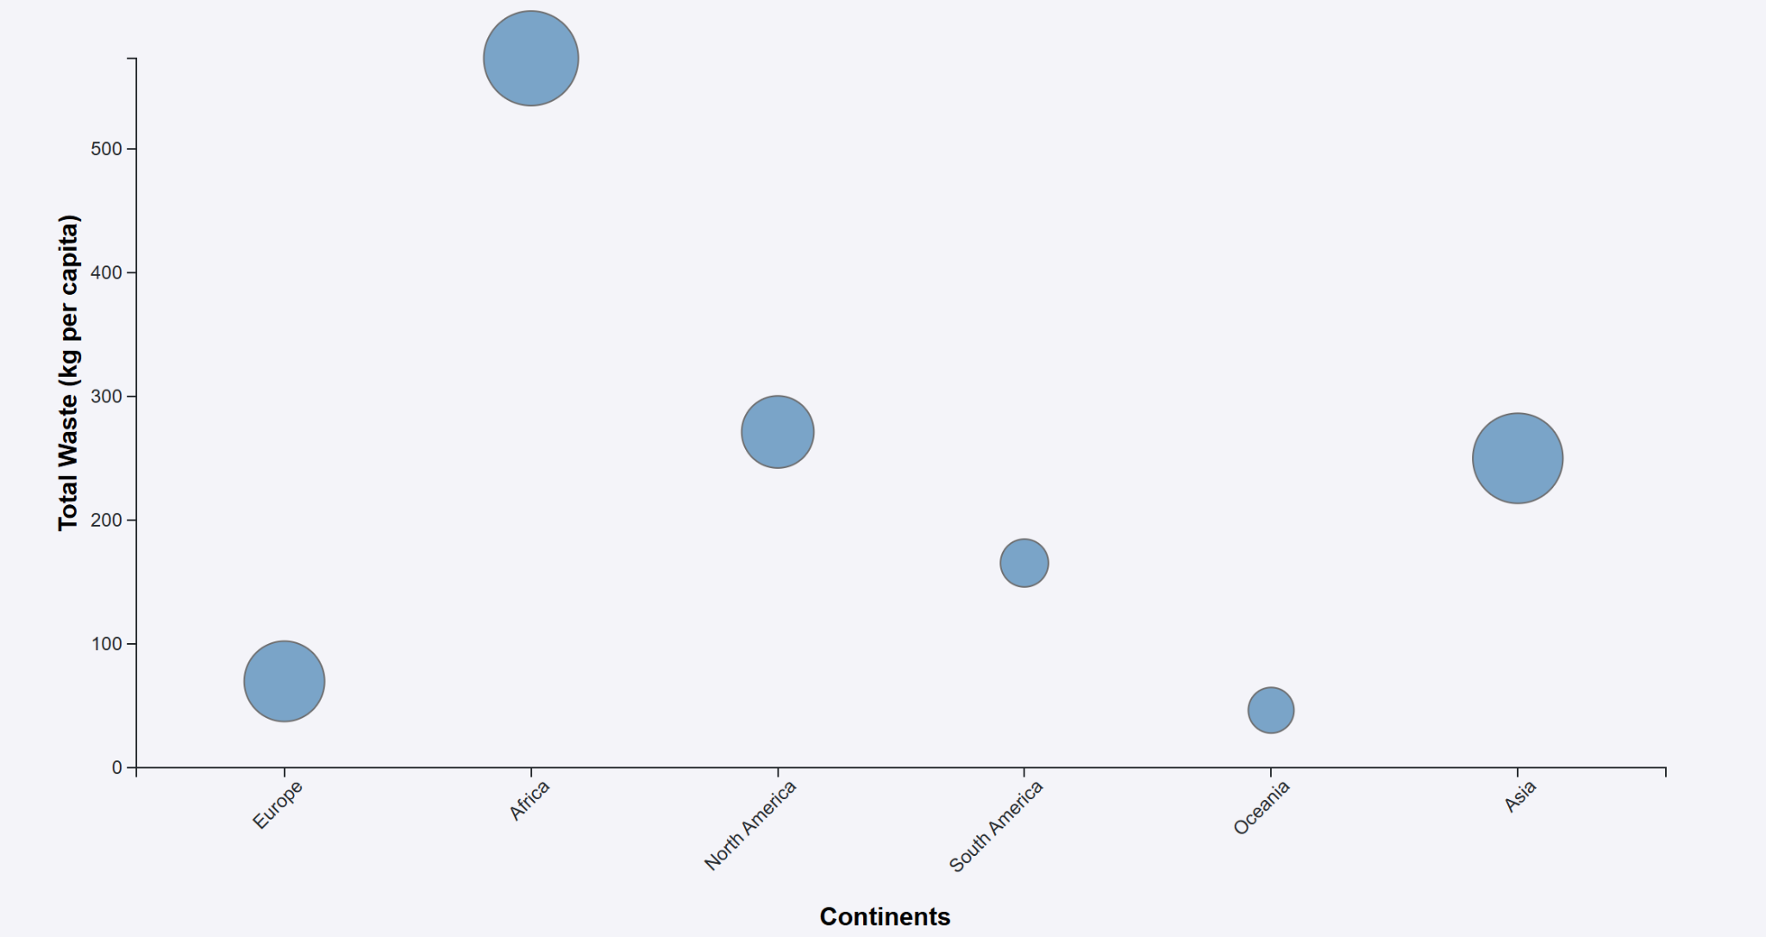

Slide 12
Data Cleaning Process
Handling Missing Values: Some datasets had missing values that needed to be addressed. Depending on the dataset, missing values were either filled using interpolation or removed if deemed unnecessary.
Normalization: Data were normalized where necessary, especially for datasets that spanned different units or magnitudes, to ensure consistency across visualizations.
Formatting and Structuring: The datasets were formatted to ensure uniformity in date formats, column names, and data types, facilitating smoother analysis and visualization.

Slide 13
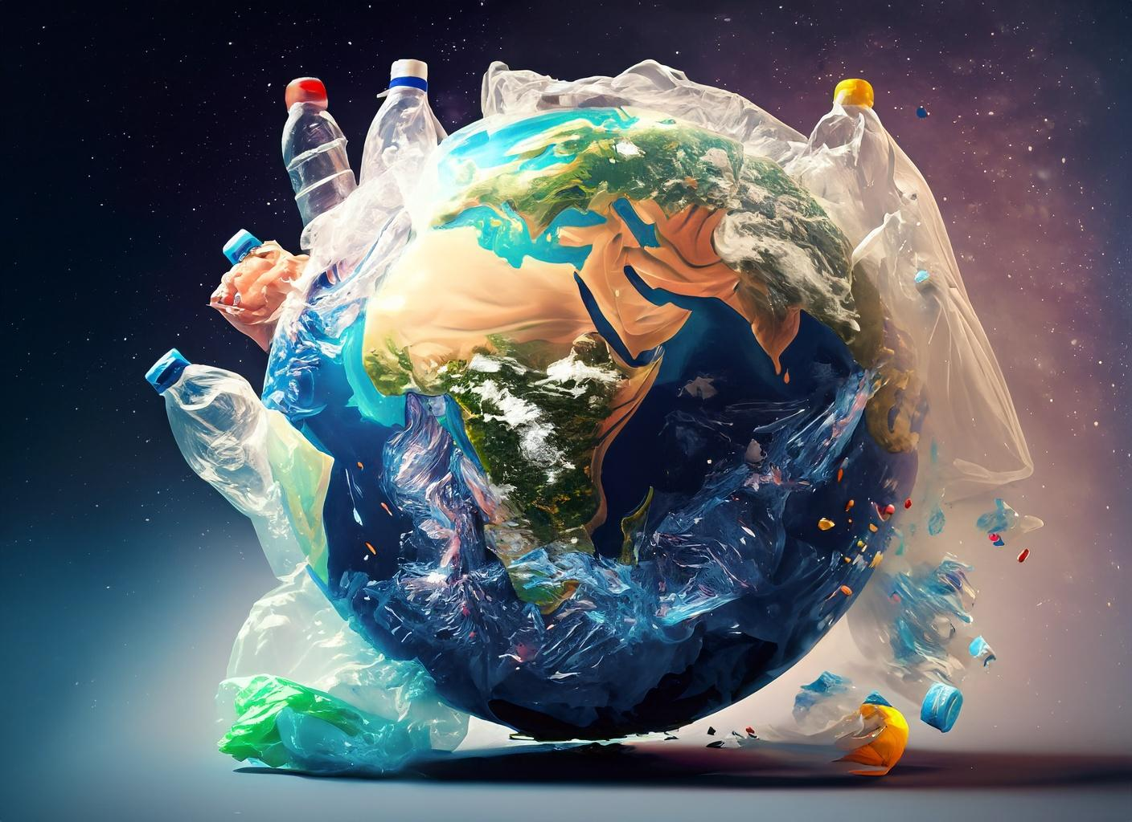
Context of the Project
The primary context of the project was to explore the global challenge of plastic waste. With growing concerns about environmental sustainability, this project aimed to shed light on the scale of plastic production, the proportion that ends up in oceans, and the fate of this waste. This data-driven approach provides a clearer picture of the challenges in managing plastic waste and the global disparities in waste management practices.

Slide 14
Demonstration of the Product
The final product of this project is a series of visualizations that provide insights into the global plastic waste crisis. These visualizations can be demonstrated using a presentation that includes the following:
1.Global Trends in Plastic Production: A line chart showing the annual production of plastics globally, illustrating the growth trend over the years.
2.Mismanaged Plastic Waste per Capita: A choropleth map highlighting countries with the highest per capita mismanagement of plastic waste.
3.Plastic Waste in the Ocean: A stacked bar chart illustrating the share of global plastic waste that ends up in the ocean.
4.Fate of Plastic Waste: A bubble chart depicting the distribution of plastic waste across various management outcomes like recycling, incineration, and mismanagement.

Slide 15
Justification of Visualization
The selection of visualizations in this project was driven by the need to effectively communicate complex data in a way that is both informative and accessible. Each type of visualization was chosen based on the nature of the data and the specific questions we aimed to answer.
Line Chart for Global Trends in Plastic Production:
Justification: Line charts are ideal for displaying trends over time, making them perfect for showing the increase in global plastic production. This visualization allows for a clear understanding of how plastic production has escalated over the years, providing context for the resulting waste management challenges.
Effectiveness: It effectively highlights significant increases or declines in production, making it easier to correlate these with global events or policy changes.

Slide 16
2.Choropleth Map for Mismanaged Plastic Waste per Capita:
Justification: Choropleth maps are particularly useful for geographical data as they show variation across different regions. By using a map, we can easily highlight which countries contribute the most to mismanaged plastic waste per capita, making it visually evident which regions require urgent attention.
Effectiveness: The use of color gradients allows for an intuitive understanding of the data, where darker shades can indicate higher levels of mismanagement, thereby drawing attention to critical areas.

Slide 17
3.Stacked Bar Chart for Plastic Waste in the Ocean:
Justification: Stacked Bar charts are excellent for comparing different categories or components, making them suitable for displaying the share of plastic waste that ends up in the ocean. A pie chart can also be used if we want to emphasize the part-to-whole relationship.
Effectiveness: These charts provide a clear and immediate visual of the proportion of plastic waste in the ocean, facilitating comparisons across different categories or time periods.

Slide 18
4.Bubble Chart for the Fate of Plastic Waste:
Justification: Bubble bar charts allow for the comparison of different categories within a total, making them ideal for showing the distribution of plastic waste between recycling, incineration, and mismanagement. This helps in understanding how different waste management strategies contribute to overall outcomes.
Effectiveness: This visualization allows for easy comparison while also showing the total volume of waste, offering a comprehensive view of how plastic waste is managed globally.

Slide 19
Effectiveness of Technologies and Techniques
The technologies employed for the development of the product included are:
Handling CSV data files: Alter the data manually by adding necessary values and deleting the unnecessary data for data cleaning purpose.
HTML: Structured the project’s content and layout using HTML for a clear and organized interface.
CSS: Styled the project with CSS to ensure a visually appealing and responsive design.
Javascript: Enabled interactivity and dynamic content updates using JavaScript.
D3.js: Created interactive and data-driven visualizations using D3.js.
These tools collectively ensured that the data was not only processed correctly but also presented in an engaging and informative manner.

Slide 20
Questions Addressed by the Visualizations
The visualizations aimed to answer several critical questions:
How has global plastic production changed over time? The line chart of plastic production over the years addresses this.
Which countries are the largest contributors to mismanaged plastic waste? The heatmap or choropleth map identifies these countries.
What proportion of plastic waste ends up in the ocean? The bar chart or pie chart on ocean plastic waste provides insights into this.
What is the fate of plastic waste globally? The stacked bar chart categorizing waste into recycling, incineration, and mismanagement answers this question.

Slide 21
Legal, Ethical, Social, and Security Issues
Legal Issues:
Data Privacy and Ownership: One critical legal concern is ensuring that the data used does not violate any copyright or data ownership laws. Since the data likely originates from governmental or international organizations, it’s essential to verify that these datasets are public domain or that proper permissions have been obtained for their use.
Data Accuracy: Misrepresentation of data could lead to legal challenges, especially if the visualizations are used to inform public policy or corporate strategies. Ensuring data accuracy is crucial in preventing legal ramifications.

Slide 22
Ethical Issues
Bias and Representation: Care must be taken to avoid introducing bias in the visualizations. For example, emphasizing certain countries over others in a way that might unfairly represent them as more problematic could lead to ethical concerns. All visualizations should aim to present data fairly and without distortion.
Responsibility to Inform: Given the potential impact of these visualizations on public perception, there is an ethical responsibility to ensure that the data is presented truthfully and in a way that does not mislead. This includes avoiding overly complex visualizations that might confuse rather than inform the audience.

Slide 23
Social Issues
Global Disparities: The data may highlight significant disparities between developed and developing nations in terms of plastic waste management. While it's important to highlight these issues, there’s also a need to be sensitive to the socio-economic factors that contribute to these disparities, avoiding any insinuation that certain countries are solely to blame.
Public Awareness and Action: The visualizations have the power to influence public opinion and potentially drive social change. However, they must be designed in a way that encourages constructive action rather than inciting fear or hopelessness.

Slide 24
Security Issues
Data Security: Although the datasets used in this project are likely to be of public nature, any analysis that integrates additional data sources (like private company data) must ensure that no sensitive or confidential information is exposed. Proper data anonymization techniques should be applied where necessary.
Information Integrity: The integrity of the data and the final visualizations must be maintained to prevent unauthorized alterations. This includes securing the data and ensuring that the visualizations cannot be tampered with once published.

Slide 25
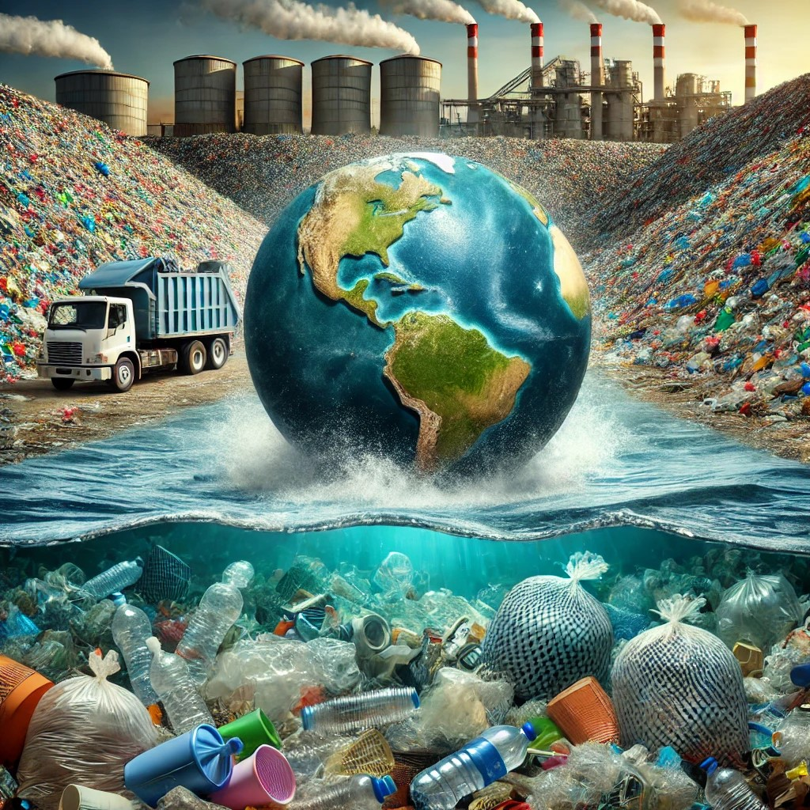
Conclusion
This project underscores the urgent need for better global plastic waste management. The rapid increase in plastic production has outpaced waste management capabilities, especially in developing regions, leading to significant environmental harm, particularly in oceans.
Addressing these challenges is crucial for mitigating the environmental impact and moving towards a more sustainable future.

Slide 26
References
Data set: https://www.kaggle.com/datasets/imtkaggleteam/plastic-pollution
Line Chart: https://d3-graph-gallery.com/graph/line_basic.html
Choropleth Map: https://d3-graph-gallery.com/choropleth.html
Stacked Bar Chart : https://d3-graph-gallery.com/graph/barplot_stacked_basicWide.html
Bubble Chart: https://d3-graph-gallery.com/graph/bubble_template.html

Slide 27


